Slide 1
Office Solutions Development
Topic 6:
Using Macros in Microsoft Word
Notes:
NCC Education - Title Master

Slide 2
Scope and Coverage
This topic will cover:
  How macros can be used in Microsoft Word and how to create and execute them.
Notes:
NCC Education - Slide Master

Slide 3
Learning Outcomes
By the end of this topic, students will be able to:
  Create a macro in Microsoft Word
  Assign a macro to the keyboard
  Assign a macro to a button
  Format text or pictures using a macro
  Customise headers and footers using a macro
  Secure their documents against malicious macros

Slide 4
Terminology
  Terminology will be explained in the lecture, tutorial and laboratory session. You should take notes!
  Ask questions if you do not understand.

Slide 5
Uses of Macros in Microsoft Word
  Macros can be used in Word for tasks such as:
    formatting text
    formatting pictures
    customising headers and footers
    opening often used files
    printing
    Entering data

Slide 6
Creating a Macro in Word
  Plan your macro - you should plan the steps that you want a macro to perform before you record or write it (remember the importance of planning was discussed in Topic 2, Slide 18).
  A macro that is used often can be assigned to shortcut keys and buttons without having to open the Macro dialogue box.
  A macro can be created by either recording it using the Macro recorder or writing VBA code in the VB Editor.

Slide 7
Overview of Recording a Macro
  The macro recorder is turned on.
  A name for the macro is entered, it can be assigned to a button or the keyboard, it is saved and a description can be given to it (optional).
  The recorder is started.
  Steps for the macro are entered.
  The recorder is stopped.

Slide 8
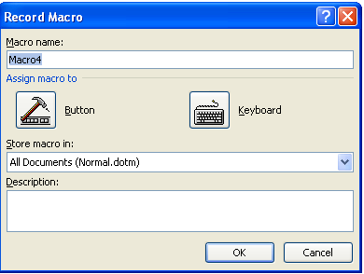
Turning on the Macro Recorder
  Select the Macro option.
  The Record Macro dialogue box is displayed and here you can:
  - name your macro
  - assign your macro to a button
  or the keyboard
  - save your macro
  - describe your macro

Slide 9
Naming a Macro
  The name must begin with a letter.
  It must not contain spaces.
  The underscore must be used to separate words.

Slide 10
Saving a Macro in Word
  When a macro is created, it can be saved in either the document in which it has been created, or saved to all Word files, e.g. a macro that formats a header and footer with the date, time and page numbers can be saved so that all Word files can execute the macro, not just the file in which it was created.
  Before a macro is recorded, Word asks the user if they want the macro available to all files or just the file in which it is being created.

Slide 11
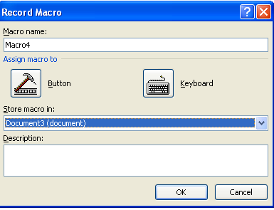
Saving a Macro - 1
To save a macro that will be used in just the document in which it was created, select Document under the Store macro in: option

Slide 12
Saving a Macro - 2
To save a macro that can be executed from any Word document, select All Documents under the Store macro in: option

Slide 13

Beginning to Record a Macro
  Perform each action that you want to include in the macro.
  The mouse can be used to click on commands and options, but the macro recorder cannot record mouse actions, so to move the insertion point or select, copy, or move text, you must use keyboard commands.
  To stop recording your macro, switch off the Record button.

Slide 14
Running a Macro
  If the macro has not been assigned to a keyboard command or a button, the following must be done:
    Select View > Macro > View Macros
    Under Macro Name, select the macro to be run.
    Click on the Run button.

Slide 15
Assign a Macro to the Keyboard - 1
  A macro can be assigned to a keyboard command – this makes it quicker and easier to perform.
  Short cut commands for a macro must begin with either:
  - Ctrl + a letter or number
  - Alt + a letter or number
  - Ctrl + Alt + a letter or number
  Note that some keyboard commands are already assigned to other Word commands, e.g. Ctrl + F is already assigned to the Find command, Ctrl + Alt + F is assigned to the Insert Footnote command, but Alt + F is unassigned so could be used.

Slide 16
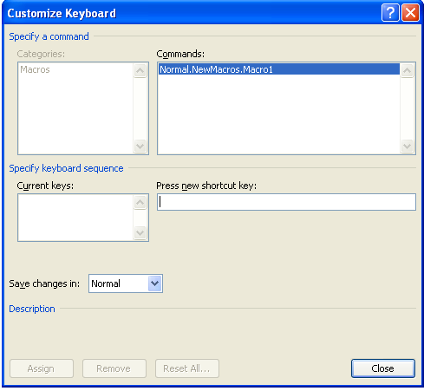
Assign a Macro to the Keyboard - 2
  Access the Record Macro dialogue box and click on the keyboard icon.
  The Customize Keyboard box is displayed.
Enter different keyboard combinations under Press New Shortcut Key until you discover one that is unassigned.

Slide 17
Assign a Macro to the Keyboard - 3
  Click on a combination of keys – if the combination is already assigned, the command will be displayed under Currently Assigned To:
  Click on the Assign button.
  Select Close.
  Click on the keyboard command to run the macro.

Slide 18
Assign a Macro to a Button - 1
  A macro can be assigned to a button – this makes it quicker and easier to perform.
  After accessing the Record Macro dialogue box and naming the macro, click on the Button icon.
  The Customize Quick Access Toolbar dialogue box opens.
  Select the macro and add it to the right hand column.
  Click on Modify.
  The Modify Button box appears.

Slide 19
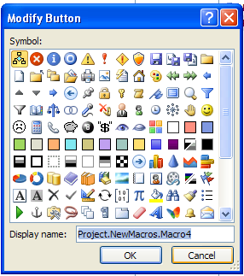
Assign a Macro to a Button - 2
  The Modify Button can be used to change the button image, assign a short name and set other defaults for the macro.

Slide 20

Assign a Macro to a Button - 3
  Select an icon from the Modify Button box, click on OK twice and the icon will appear on the Quick Access Toolbar:
  The macro can now be run by simply clicking on the icon!

Slide 21
Format Text - 1
  Open a blank Word document and enter some lines of text or open an existing document.
  Highlight some text
  Select Format > Font
  Select Arial > Bold > size 14 > OK
  Stop the Macro Recorder.
  The macro is now recorded.

Slide 22
Format Text - 2
  Enter some text and highlight it.
  Click on View > Macro > View Macros
  Select the macro and click on the Run button.
  The highlighted text will change to Arial, Bold and size 14.

Slide 23
Customise Headers and Footers - 1
  A macro can be created that inserts the current date/time and filename in the header and the page number in the footer. It can be created as follows:
    Open a blank document in Word.
    Select View > Macro > Record Macro
    Save your macro in All Documents.
    Enter a short description of the macro, your name and the date in the Description section.
    Click on the Button icon.

Slide 24
Customise Headers and Footers - 2
  Click on the macro and add it to the right hand column.
  Click on the Modify Selection button.
  Select the button image.
  Click on OK - the macro is now recording.
  Select Insert > Footer > Date and Time

Slide 25
Customise Headers and Footers - 3
  Select a format then click on OK.
  Select Page Number >
  Select Bottom of Page.
  Stop recording
  Open a new document.
  Run the macro.

Slide 26
Security and Macros
  Ensure that you set the security level to the second option when working with macros in Word.
  Read also the following information:
  http://www.msoffice-tutorial.com/macro-security.php

Slide 27
References
  Gonzalez, J., Meister, C., Ozgur, S., Dilworth, B., Troy, A. and Brandt, T. (2006). Office VBA Macros You Can Use Today: Over 100 Amazing Ways to Automate Word, Excel, PowerPoint, Outlook & Access. Holy Macroi Press.
  Microsoft Office: Macros and Word 2003. (2011). http://office.microsoft.com
  Microsoft Office: Macros and Security. (2011). http://www.msoffice-tutorial.com/macro-security.php

Slide 28
Topic 6 – Using Macros in Microsoft Word
Any Questions?
Notes:
NCC Education - End Slide Master

